Slide 1
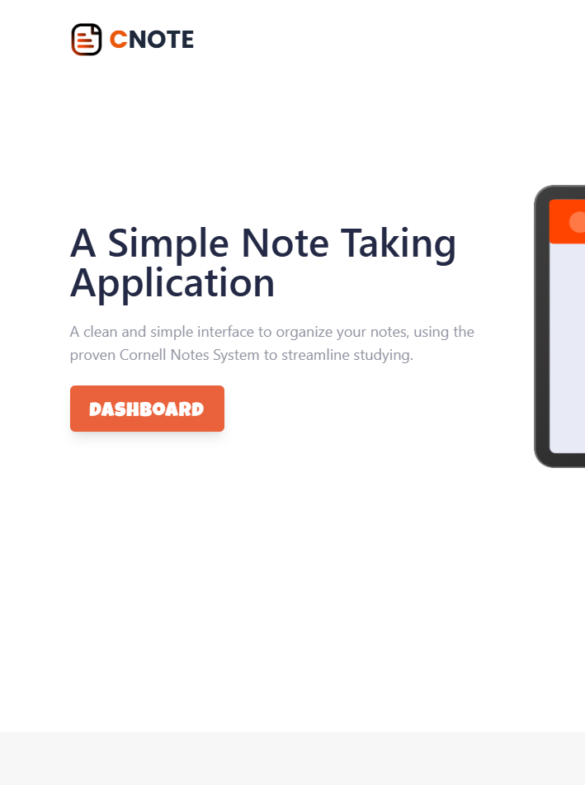
CNote
-Full Stack Web Application-
Pavel Buta

Slide 2
Project Overview
Title: CNote
Description: CNote is a lightweight web application where people can create an account, log into the new created account and write and organize their notes, which are implemented around the Cornell Note Taking System. The users can save their notes and then access them from any device.
Target audience: Mostly students, given the purpose of the Cornell System, however, any person can use the app in the everyday life.
Key features: Account registration, Folder System for organizing files, Cornell System, WYSIWYG editor - simple and efficient, Portable - you can access and modify your notes from any device.

Slide 3
Technical Stack
Frontend
Vue Js (latest version)
Tailwind CSS (Version 3)
Axios
Vite
Vue Router
TipTap (rich text editing)
State management (Pinia)
Backend
Node Js
Express JS
Database (MongoDB & Mongoose)
RESTful API architecture
JWT & bcrypt
Swagger UI for API documentation
Jest for testing

Slide 4
Frontend Implementation
Views & Components
The project was created in a clean and structural way, therefore there we have the usual organisation of the VUE CLI project with the views for most pages: HomeView, AboutView, LogInView, SignUp View, DashboardView (for the user’s dashboard) and NotFoundView (page for a non existent url).
There are also the components, which are reusable and independent as much as possible: NavBar, FooterSection, HamburgerMenu (for mobile navigation), FormCard (for the sign up and log in forms), ToastComponent (for displaying errors or messages to the user), FolderSystem (the main organisation system for the files of the user), FolderItem (an instance of a folder/note), MoveItemPopUp (for displaying where the item can be moved in the folder system) and the MainScene ( the area of the 3 inputs for note taking and where the text editor is).

Slide 5
2. Routing
Given that CNote is a SPA, we have the routing system implemented through Vue Router. We have a single file, index.js, which has 6 main routes:
/home - The first route which is imported directly, uses the HomeView
/about - Lazy loaded route for the AboutView
/sigup - Lazy loaded route for the SignUpView
/login - Lazy loaded route for the LogInView
/dashboard - Lazy loaded and also protected route where only authenticated users have access for the DashboardView component
/not-found - Lazy loaded route which catches all other routes that don’t match/exist
3. State Management
In the structure of CNote we have a combination of services and stores to ensure a persistent state. The stores are: userStore (for user state), noteStore (for handling all the notes), folderStore (for working with the folders) and a small notificationStore (for the UX). And for helping to separate concerns we have the 3 services: authService, noteService and folderService, which handle the API requests, but we also have a axiosInstance.js file, which centralizes axios configuration: attaches auth tokens, auto-refreshes on 401 errors, and handles logout.

Slide 6
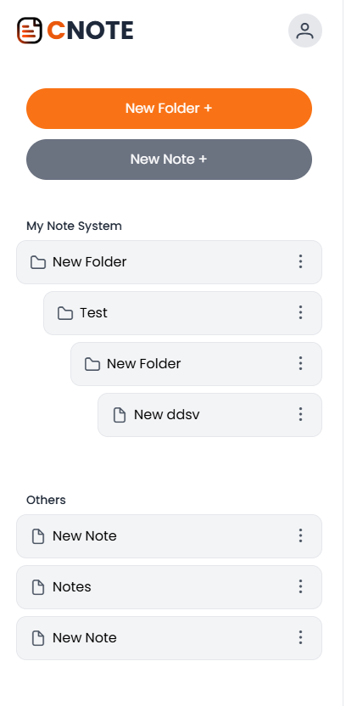
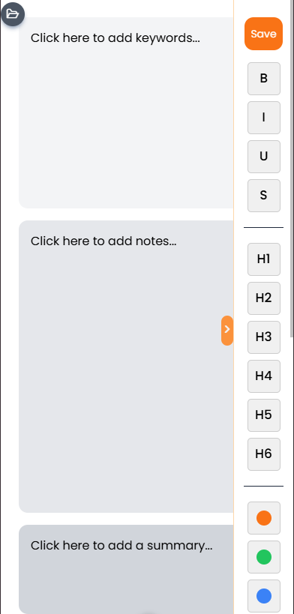
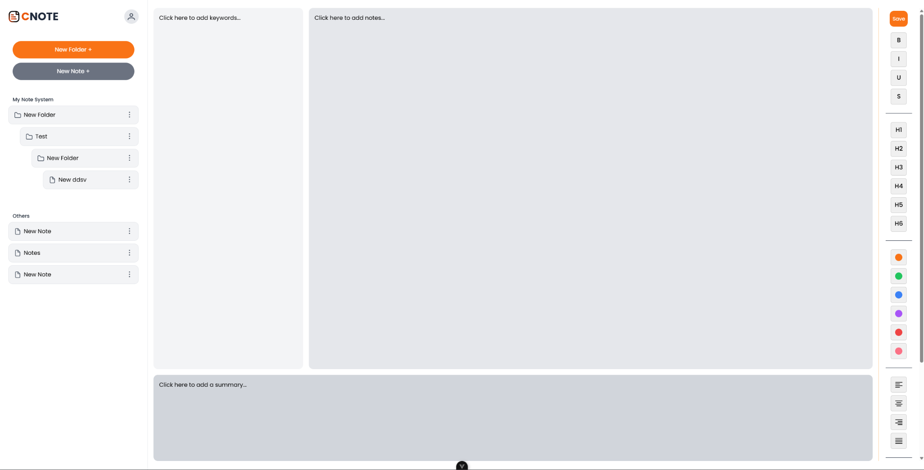
4. User Interface
First off, CNote is a fully cross-browser compatible application. There were no special or edge cases implementations used that might be available only on some of the most known browsers.
Second, the application is fully responsive. All the views and components adapt to the screen size using the media breakpoints provided by Tailwind CSS. There is a dedicated HamburgerMenu component for navigating the routes like /home, /about and the login and sign up forms, and in the dashboard, both the folder system and the text editor are retractable such that the screen is occupied only by the note taking area.

Slide 7
Backend Implementation
API Endpoints
The full lists of API endpoints can be found in the swagger.json file, however, here are the most important ones:
Authentication:
POST /api/auth/register – Register a new user.
POST /api/auth/login –
Log in a user.
POST /api/auth/refresh – Refresh access token.
POST /api/auth/logout – Log out the user.
Folders:
GET /api/folders – Retrieve all folders for the logged‑in user.
POST /api/folders – Create a new folder.
PUT /api/folders/:id – Update a folder.
DELETE /api/folders/:id – Delete a folder.
Notes:
GET /api/notes – Retrieve all notes.
POST /api/notes – Create a new note.
PUT /api/notes/:id – Update a note.
DELETE /api/notes/:id – Delete a note.
PATCH /api/notes/:id/folder – Move a note to a different folder.

Slide 8
2. Database Design
The choice of using MongoDB as the database for the project was a normal on, given that it is a document database that uses the JSON format, it makes is suitable especially for web application. Therefore we have 3 schemas, as they are called in MongoDB:
User - that has a username (which must be unique) attribute and a password attribute, the later one is encrypted and salted before stored
Folder - which has a name/title, a parent folder (used for nesting the folders), an array of notes (which store Note objects) and a reference to the user. This schema also have some custom validation besides the default one and a method for adding a note to the notes array.
Note - the main schema, has a title, a folderId ( used for nesting in the folder system), a user reference, a createdAt attribute (might be used in the future for sorting features), and the 3 text field values from the Cornell Note Taking System: keyPoints, detailedNotes and summary.
3. Authentication and Authorization
CNote employs robust JWT‑based authentication and authorization mechanisms to protect user data and interactions. During login and registration, credentials are securely validated, and upon success, the system issues an access token with a short expiration and a refresh token with a longer validity period. The access token is used to authenticate subsequent API requests, while the refresh token allows for seamless token renewal without re‑authentication. Additionally, middleware functions enforce authorization by ensuring that only authenticated users access their own resources, preventing unauthorized operations. This strategy not only enhances security but also provides a smooth user experience by maintaining session continuity.

Slide 9
4. Security Measures
Rate Limiting: A rate limiter middleware (e.g., express-rate-limit) protects endpoints—especially authentication—from brute-force attacks and excessive requests.
CORS Configuration: The server uses CORS settings to restrict resource sharing to trusted origins (e.g., localhost for development and your production domain) and enables credentials for secure cookie transmission.
Input Validation: Joi is used to validate all incoming data for registration, login, folder, and note endpoints. This prevents malformed or malicious inputs from reaching the database.
Password Hashing: User passwords are hashed using bcrypt before storage. This ensures that even if the database is compromised, plain-text passwords aren’t exposed.
JWT-Based Authentication: JSON Web Tokens secure authentication, with short-lived access tokens and longer-lived refresh tokens stored in HttpOnly cookies. Tokens are validated on every request to enforce authorization.
Secure Cookie Settings: Refresh tokens are stored with the HttpOnly, secure, and sameSite flags to mitigate risks like cross-site scripting (XSS) and cross-site request forgery (CSRF).
HTTPS Enforcement:
Even though it is not implemented as the project is not in production, a SSL certification can be obtained and after that use Node’s HTTPS module to ensure it.

Slide 10
Testing
As it was mentioned in the project’s criterias, the backend is tested. The testing is done through Jest and Supertest and the test are configured such that they use a mock database ( to not affect the real time database) and check the endpoints of all 3 main schemas: user, folder and note. At the same time, the tests also check indirectly the db connection given that the db is needed to perform them.
To keep the structure clean and organised, the tests are in a separate folder in the backend part of the application and can be run by executing npm test in the command line after navigating to the backend folder.

Slide 11
Version Control
The git repository structure contains 3 main components: README, frontend folder and the backendfolder.
Throughout the project I used a simple but effective branching strategy. I would create a feature branch when starting a new big feature and later on, depending on the case, that branch would have other sub branches (how it was the case with the dashboard and the folder system, which required inner branches). In this manner I was able to work at more features at the same time while also keeping everything organise. After a feature was finished I would merge them and solve any conflicts when a merge conflict occurred.

Slide 12
Documentation
The main source of documentation is the README files, which goes through the main features and details of the application CNote and at the same time mentions the steps needed to set up and install the application on a new device.
Referring to the API documentation, I used swagger for a clean way of documenting all the endpoints and their details ( methods, responses, requestBody etc). The documentation can be found by accessing
http://localhost:5000/api-docs/

Slide 13
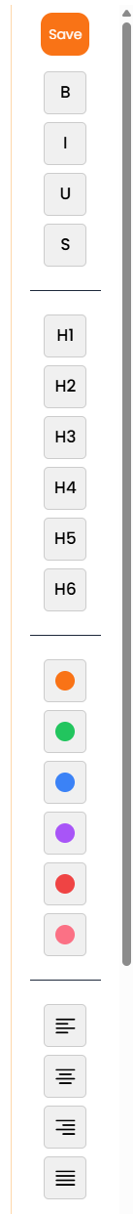
Challenges & Solutions
Besides the whole point of creating a full stack application, which in my opinion, for a beginner is a pretty challenging task (thinking the whole structure, keeping it organise and actually implementing the features), I had 2 major challenges:
The Folder System - given that the whole system uses a Tree ADT it wasn’t easy at all to come with an actually vue js implementation of it, especially because in the database you can not organise them in the same way, so I needed a lot of mapping and API calls to make sure the UI is responsive to the user’s actions.
The TipTap integration - initially I wanted to go with a simpler Markdown syntax text editor, I challenged myself to implement and design a rich text editor (WYSIWYG) given that it improves a lot the user experience.

Slide 14
Future Enhancements
Accessibility improvements - language switch, keyboard shortcuts, dark theme etc.
Media support in the note’s layout (images)
Drag-and-drop implementation of the folder system
Possibility of sharing your notes
AI generating for the summary and key points sections based only on the user notes

